Slide 1
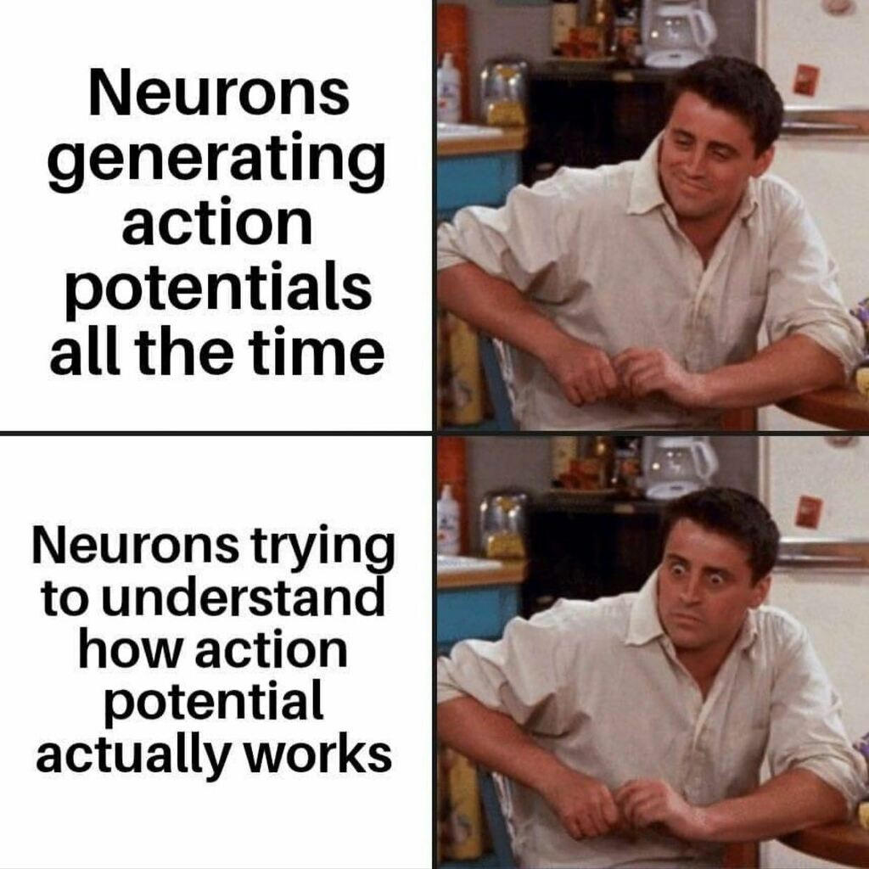
BMD ENG 301 Quantitative Systems Physiology (Nervous System)
Lecture 7: Action Potentials and Ionic Mechanisms
Emily Schafer

Slide 2
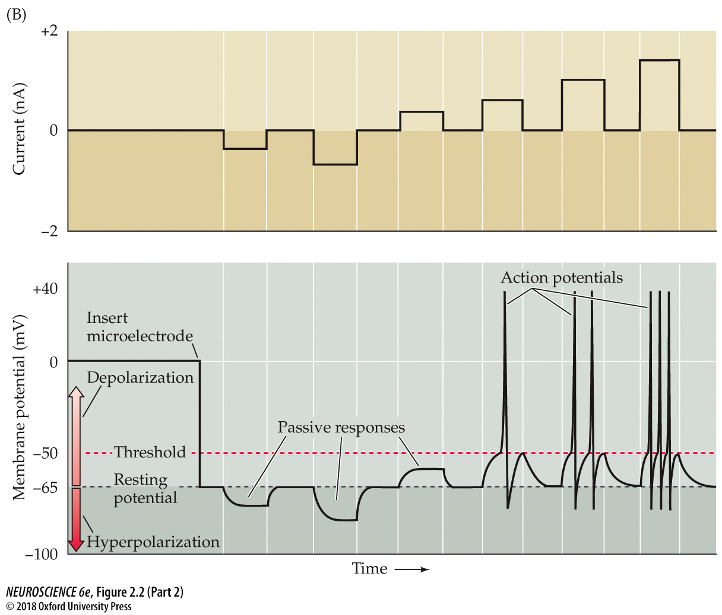
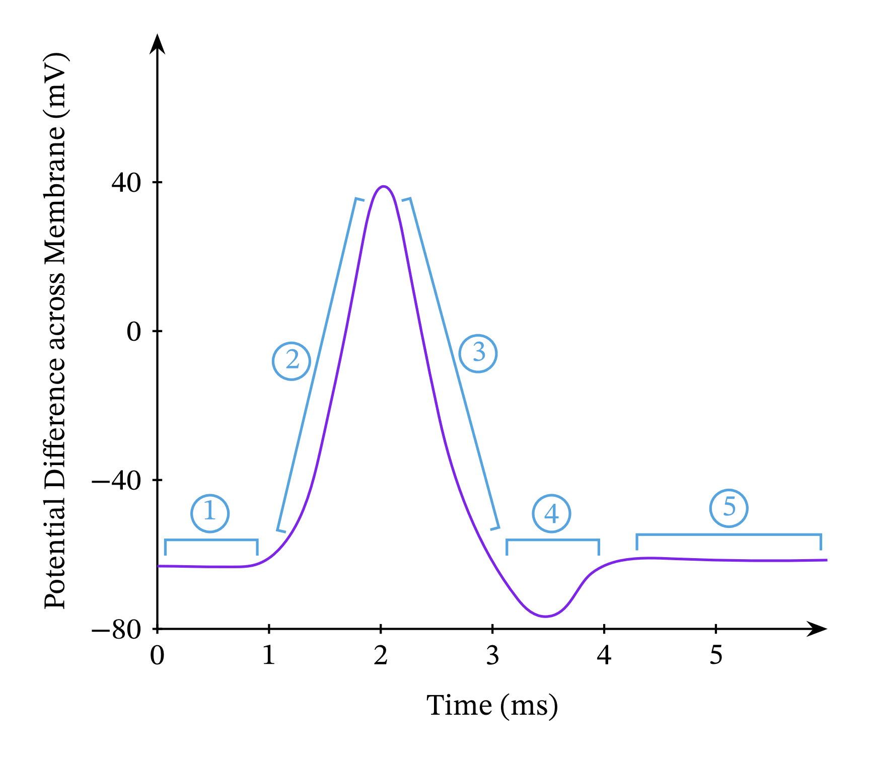

Slide 3
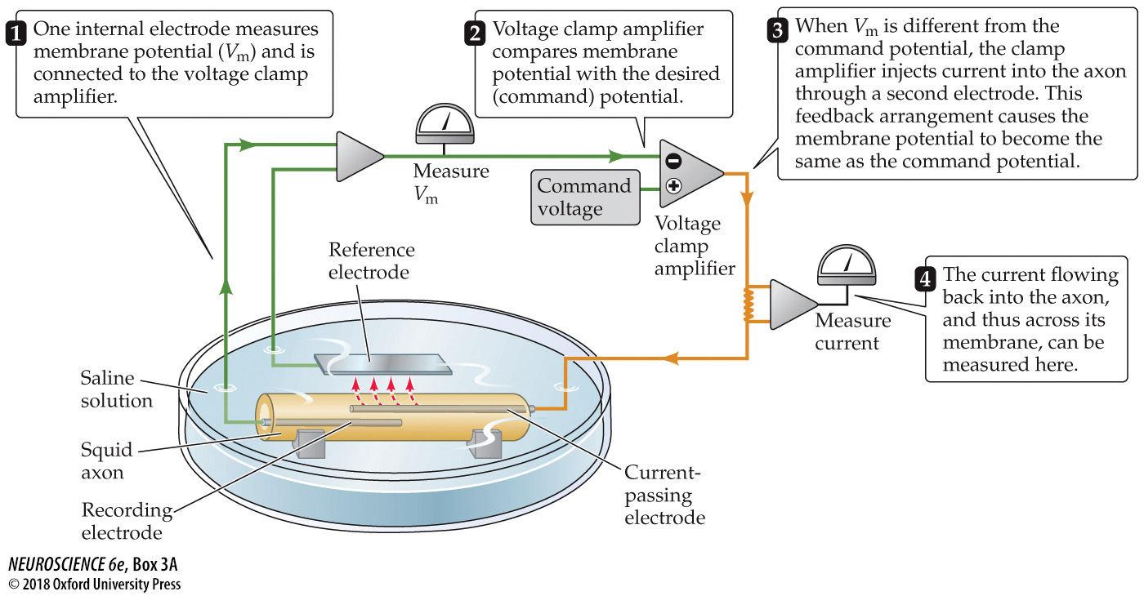
The Voltage Clamp Method

Slide 4
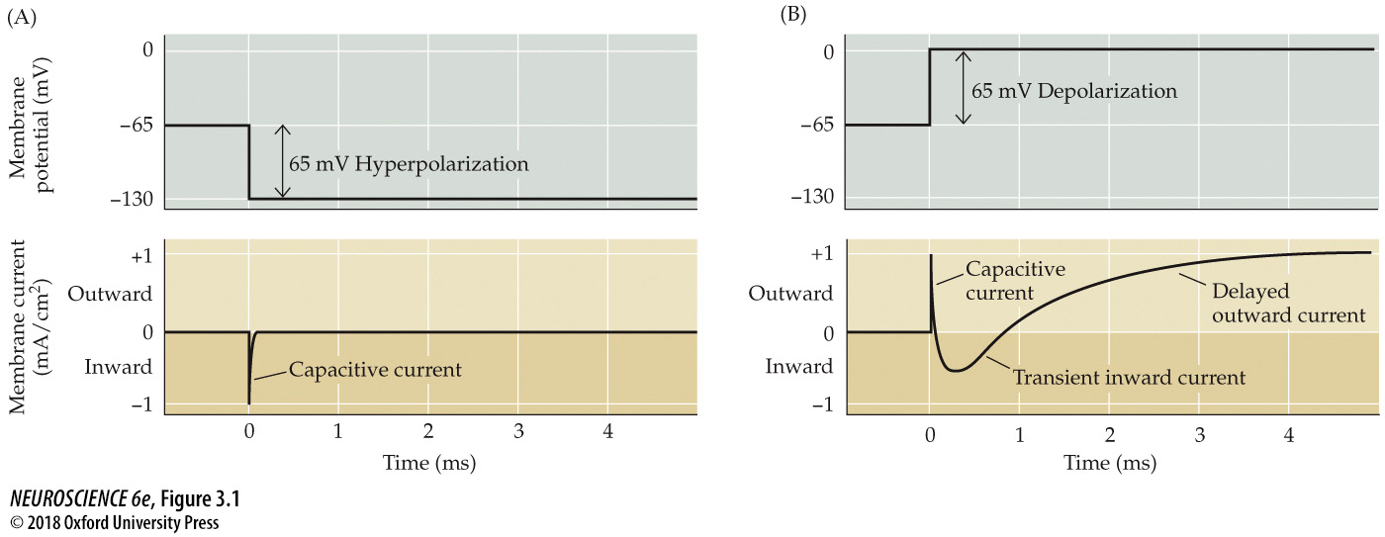
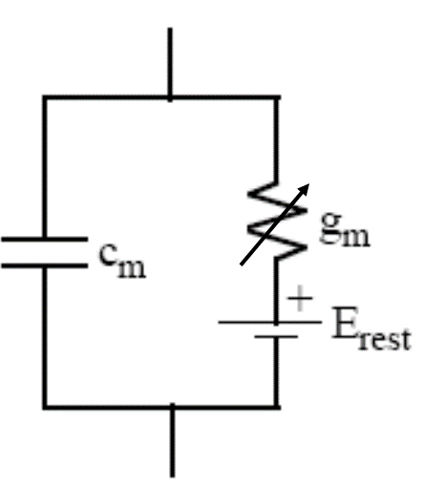
Voltage clamping allows us to discover the voltage dependence of different phenomena, like ion permeability
Remember – capacitors take time to charge and discharge!

Slide 5
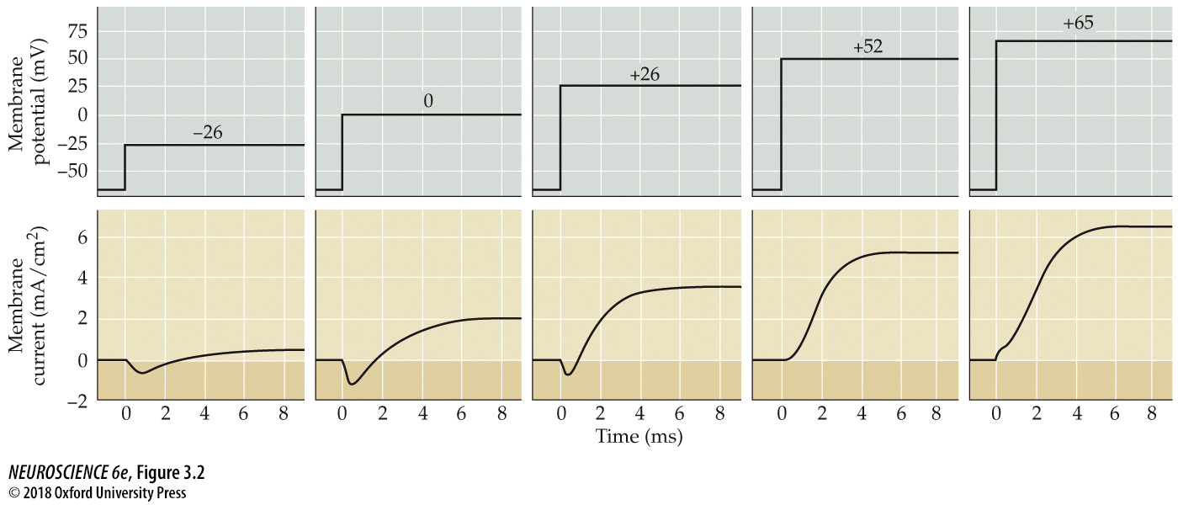
Voltage clamping allows us to discover the voltage dependence of different phenomena, like ion permeability

Slide 6
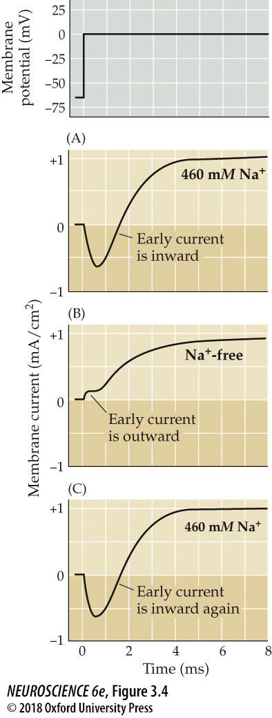
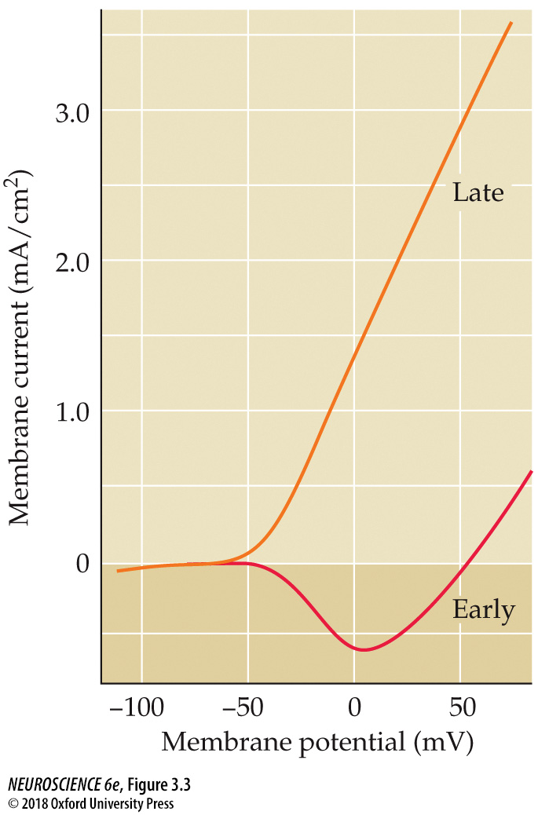
E_{Na}
E_{K}
V_{m} – E_{na}
0

Slide 7
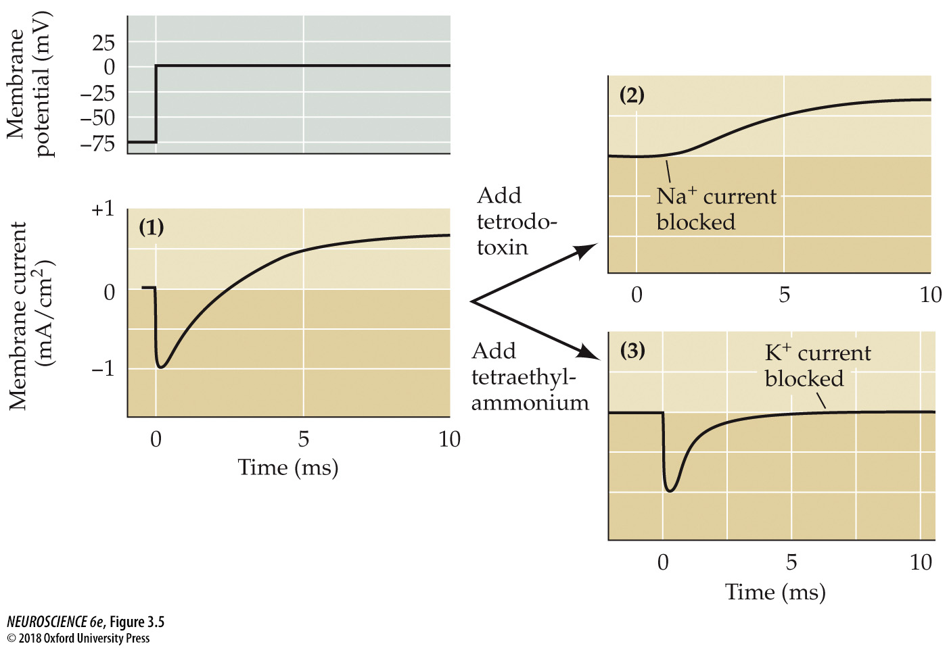
We can also pharmacologically prove which ion is responsible for which part of the current:

Slide 8
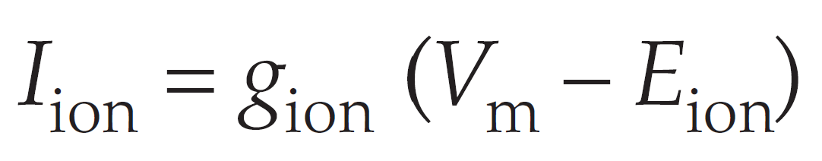
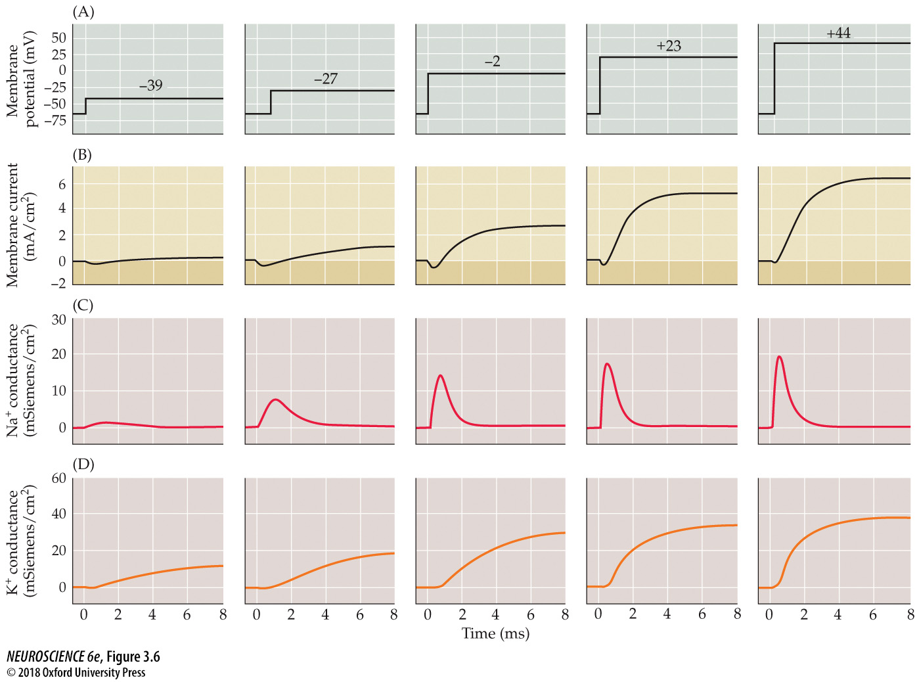
What does the conductance look like over voltage and time?
Reversal potential
(calculated based on measured concentrations)
Current (measured)
Membrane voltage
(set during clamp)

Slide 9
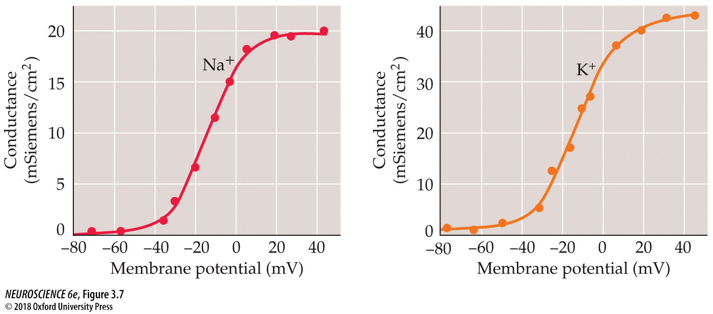
What does the conductance look like over voltage and time?
Voltage dependence of conductance after a stimulus

Slide 10
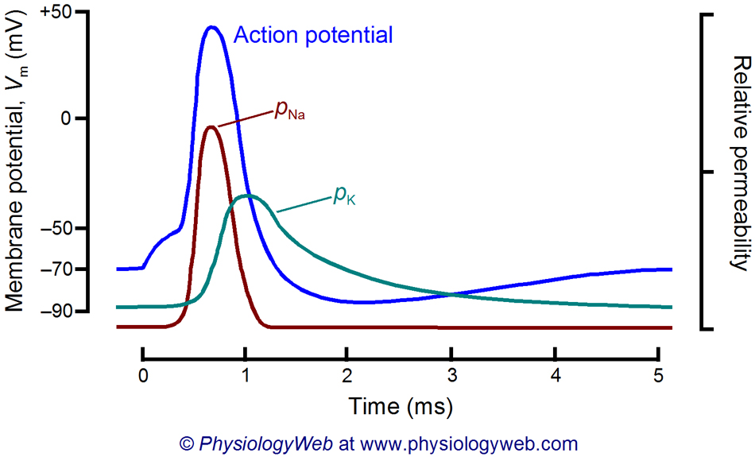
What does the conductance look like over voltage and time?
Time dependence of conductance after a stimulus

Slide 11
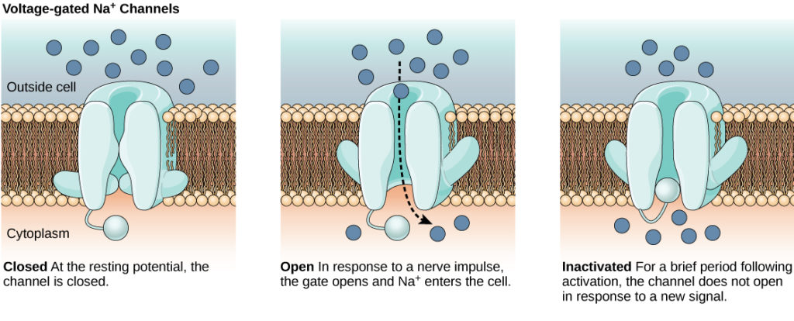
States of the Na⁺ Channel
(t)
OPEN
INACTIVATED
(↑V_{m} , t)
(↓V_{m} , t)
CLOSED
Remember: these are the states of a single channel!

Slide 12
States of the Na⁺ Channel
CLOSED
INACTIVATED
CLOSED
OPEN

Slide 13
States of the Delayed Rectifier K⁺ Channel
(↓V_{m} , t)
OPEN
CLOSED
(↑V_{m} , t)

Slide 14
States of the Delayed Rectifier K⁺ Channel
OPEN
CLOSED
Slow to open AND slow to close

Slide 15
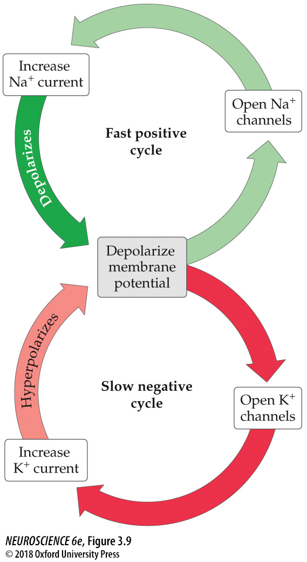
Absolute Refractory Period
Relative Refractory Period
Rising
phase-
Depolarization
Falling
phase-
Repolarization
Rest-
Ready for the next action potential
Rest
Hyperpolarization

Slide 16
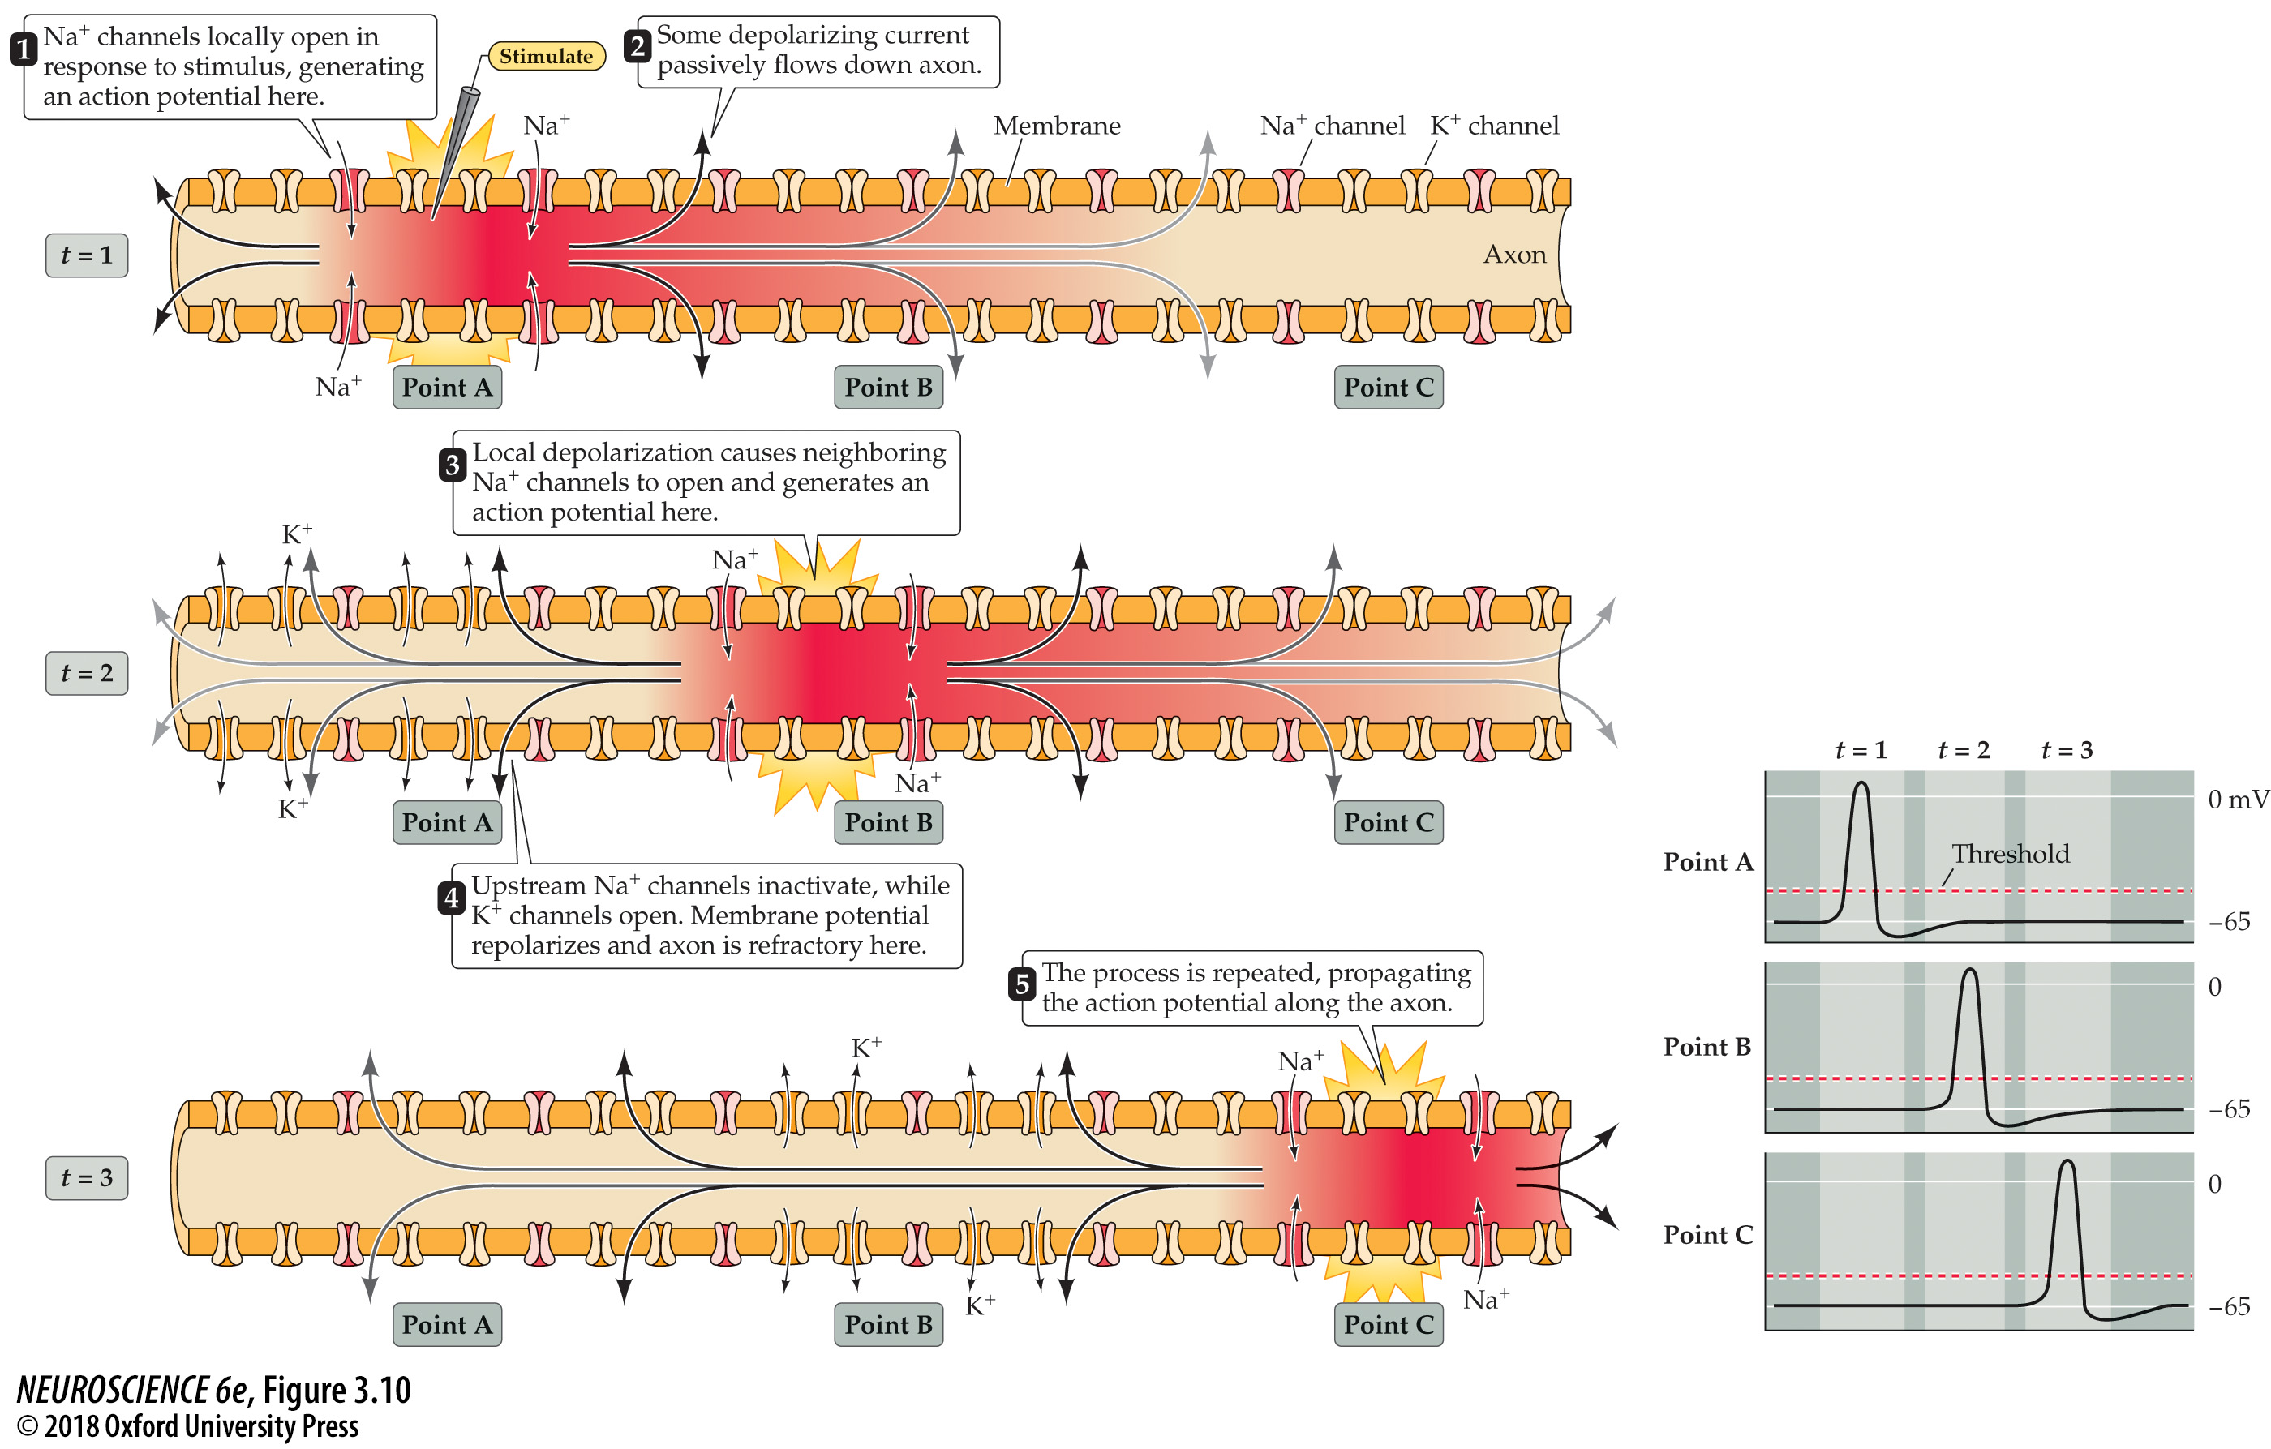
Action potential conduction requires both active and passive current flow

Slide 17
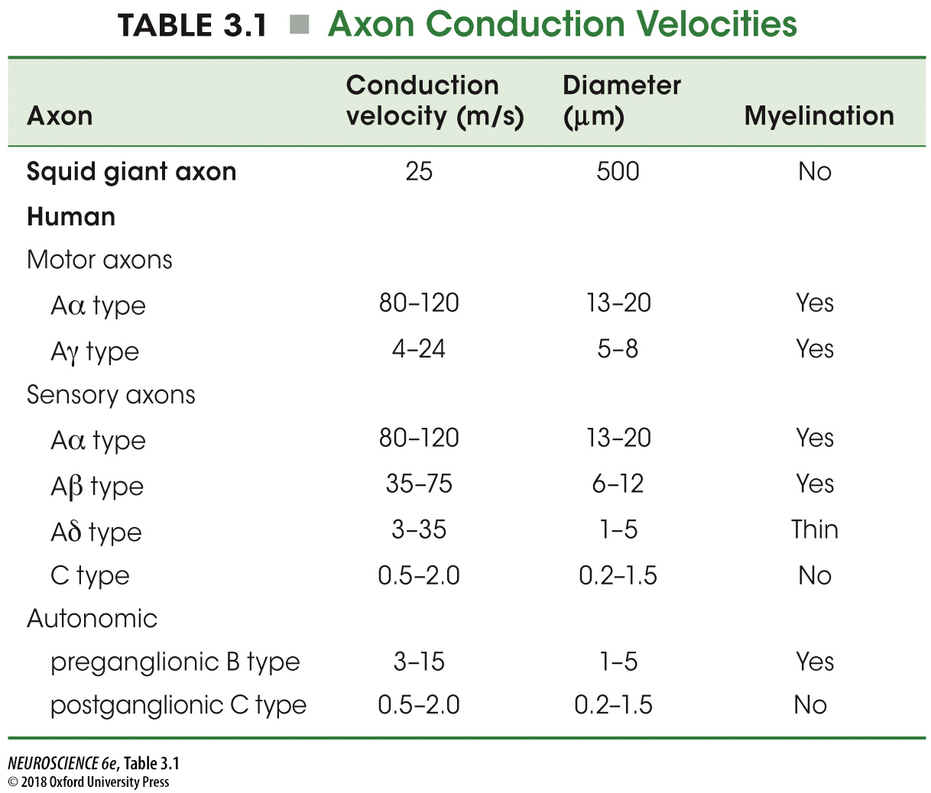
How do we make our action potentials fast?

Slide 18
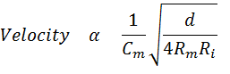
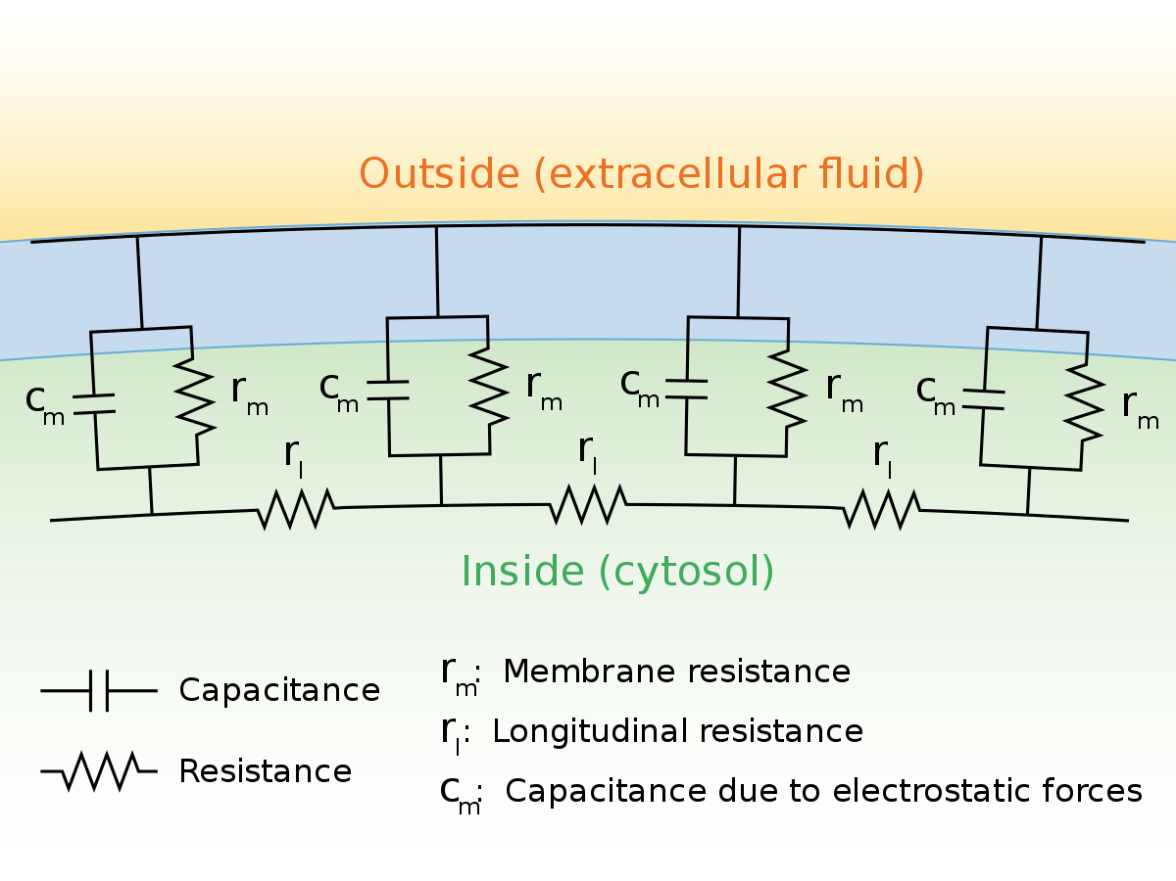
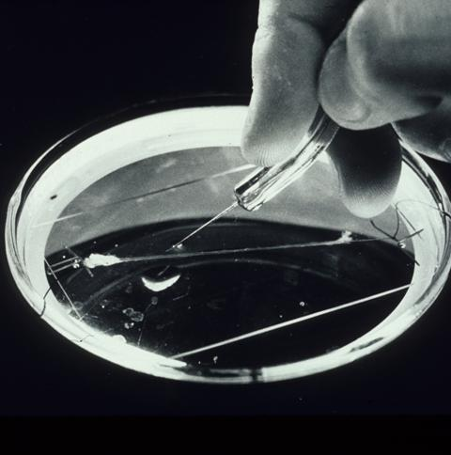
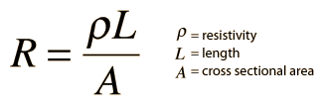
How do we make our action potentials fast?
Large diameter axon
Resistance of a “wire” varies inversely with cross sectional area

Slide 19
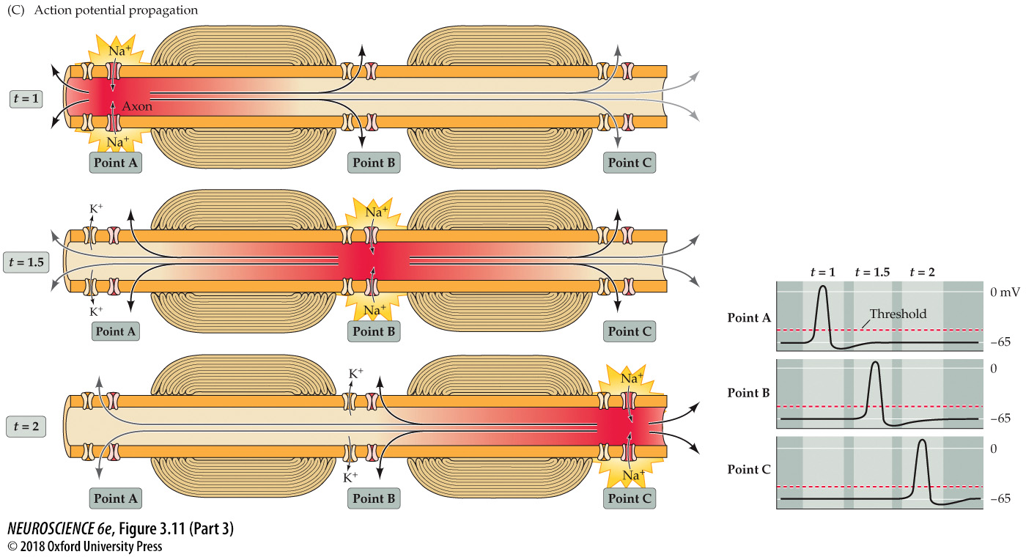
2. Saltatory conduction of action potentials The myelin sheath increases conduction speed by reducing current loss through the membrane

Slide 20
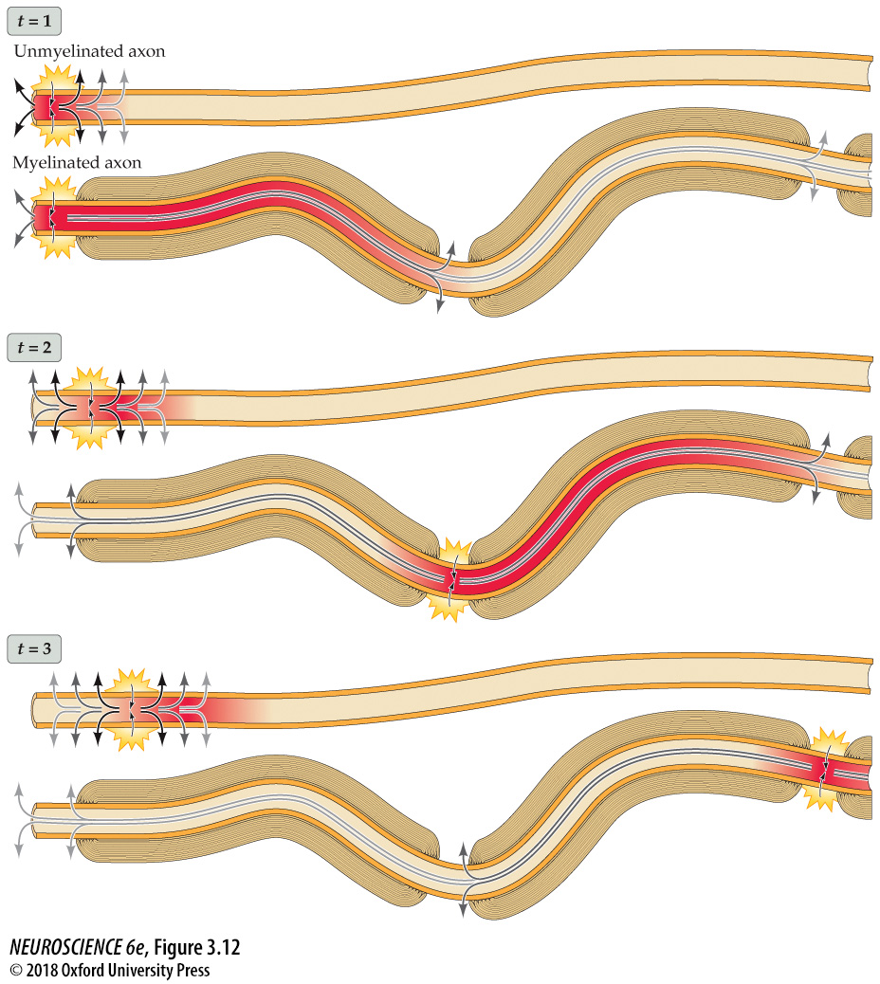
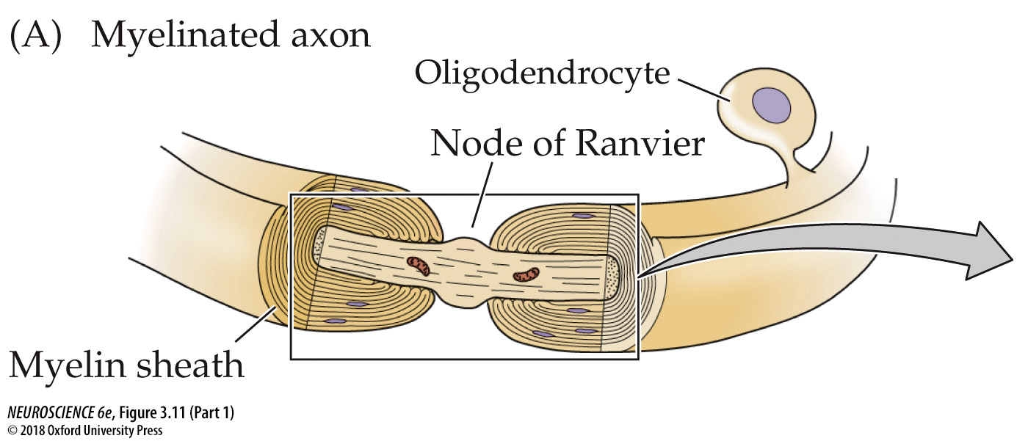
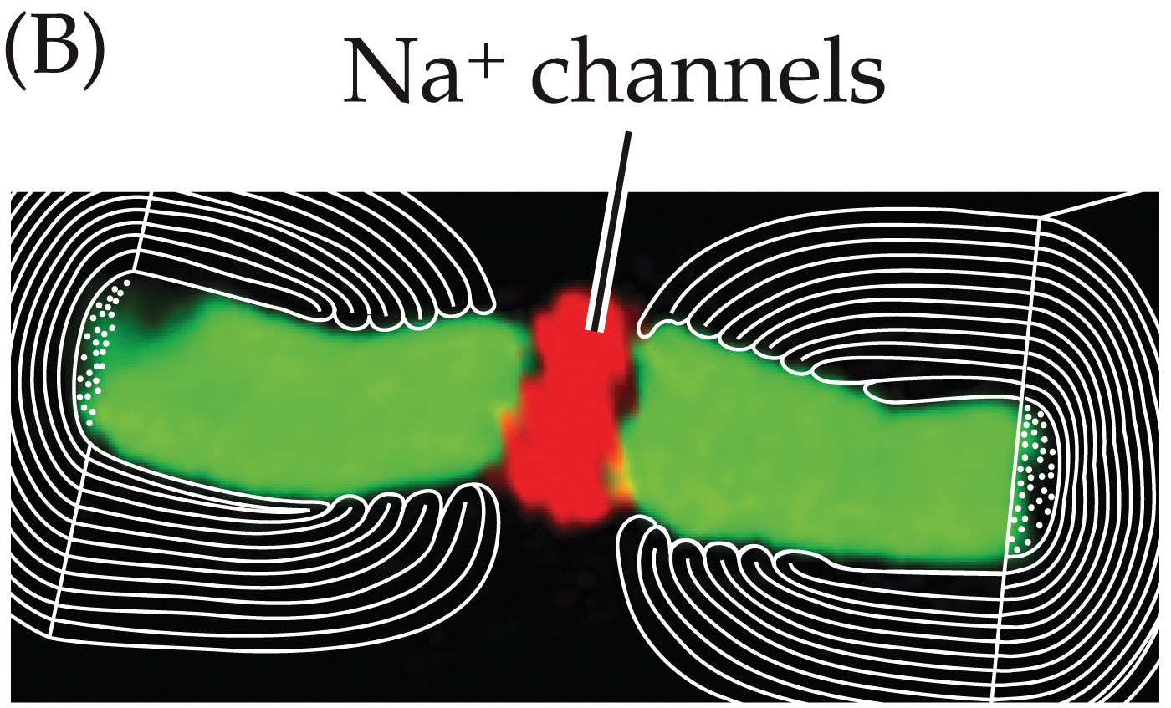
2. Saltatory conduction of action potentials

Slide 21
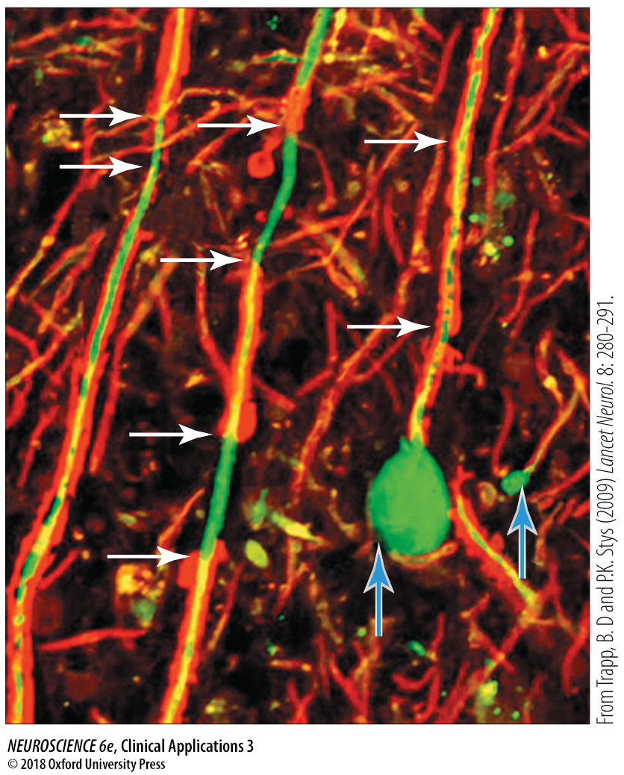
Multiple Sclerosis
Inflammation and demyelination of the central nervous system
Abnormal patterns in action potential conduction likely lead to most symptoms

